Slide 1
Design & Control of USVs for Oil-Spill Cleanup
111117036 - Gudapati Nitish
111117030 - Devarasetty Sasi Preetham
111117019 - Athithya Kumar NB
Guide - Dr. T. Ramesh

Slide 2
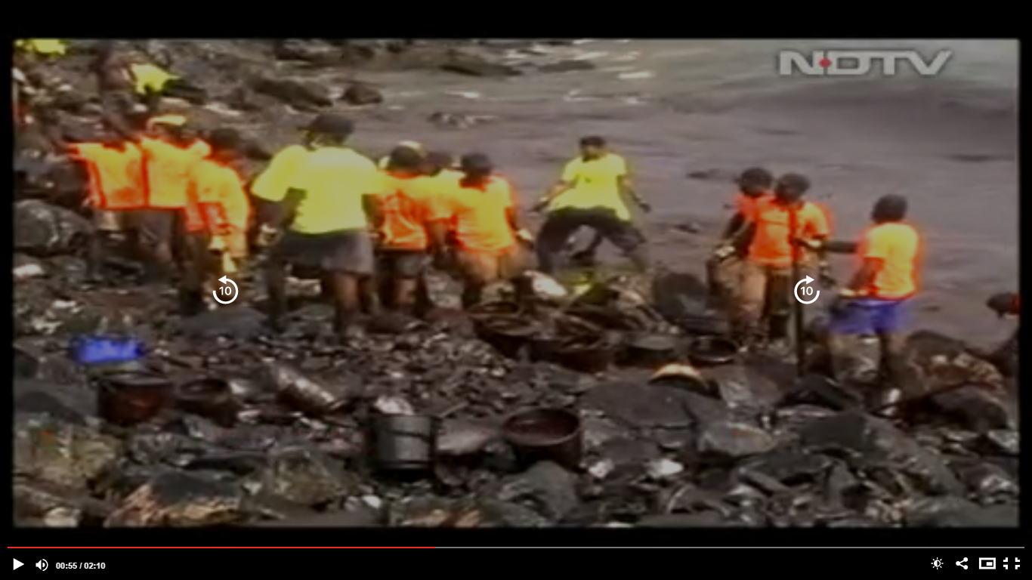
Motivation of this project
Oil-spills are one of the factors that causes terrible effects on water environment and worst holocaust to marine life.
Although there are various techniques being currently used, developing an effective & sustainable oil cleanup approach is still a challenging task due to the high cost and environmental impact involved in the current practices.
In countries like India, the government still uses manual power to clean spills if such situations occur.
Picture on the left shows manual scavenging of spilled oil in Ennore, Chennai TN happened on January 28, 2017
Source : NDTV

Slide 3
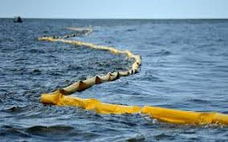
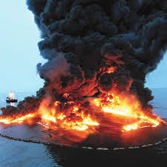
Commonly used Methods
Drawbacks
Commonly used methods for oil cleanups are:
Oil booms: Equipment that acts like a fence to prevent the oil from further.
Sorbents and Dispersants: Sorbents are materials that soak up liquids by absorption.
Burning In-situ: The oil floating on the surface is ignited to burn it off.
Skimmers: Skimmers are machines specially designed to suck up the oil from the water surface.
Booms are effective only within few hours of spill taking place and cannot handle fluctuating tides.
Use of sorbents/dispersants can be hazardous to marine life.
Burning the oil releases toxic fumes leading to environmental damage.

Slide 4
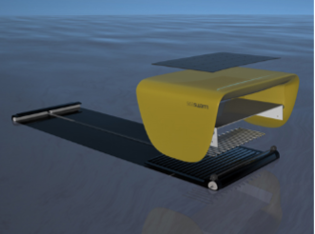
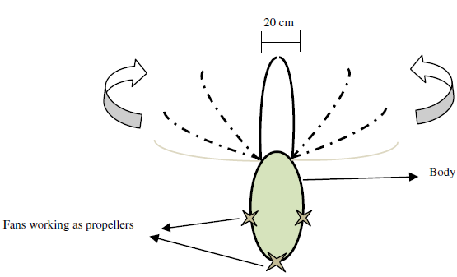
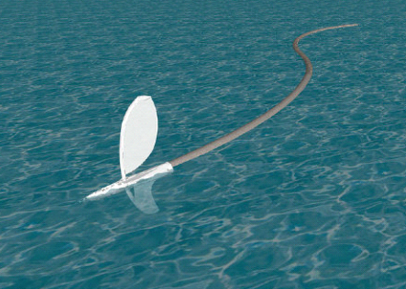
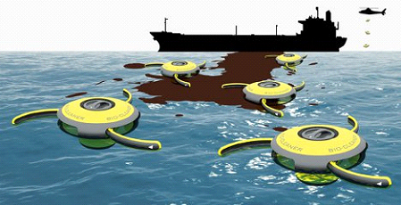
Literature Review
E M H. Zahugi, et al. “Oil Spill Cleaning Up Using Swarm of Robots”, Advances in Computing & Inf. Technology, AISC 178, pp. 215–224.
Seaswarm - MIT, Hydrophobic nano material for oil absorption, surface tension based propulsion.
Protei uses the wind to power an unmanned sailing drone, which pulls a long oil-absorbent tail upwind.
Roomba, The Bio-Cleaner system is just a concept at this point. Compartment full of bacteria to degrade the oil.

Slide 5
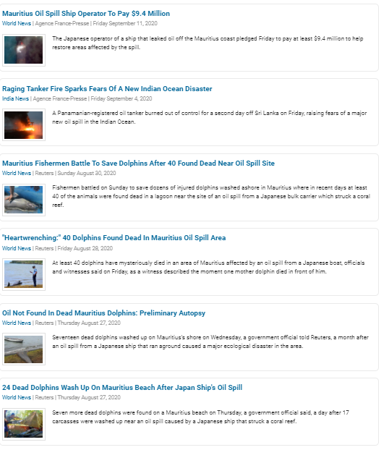
Project Outcome
Social Relevance
We proposed a design of unmanned Surface vehicles to efficiently in clear up the oil spills compared to the conventional methods.
In this project, we designed the robot, then derived the kinematics & dynamics equations and then implemented PID control for wavepoint and trajectory (Sinusoidal, Square, Circle) transversal.
Source : NDTV

Slide 6
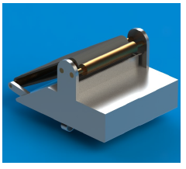
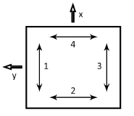
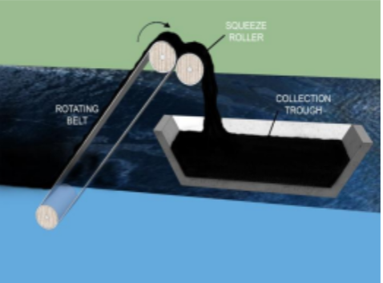
Oil Extraction Mechanism and Thruster Configuration
Oleophilic skimmer has the highest recovery rate (0.2 to 50 m^3/h) compared to other physical methods of same dimensions. [1]
USV uses a belt drive mechanism, in which the belt surface is coated with an oleophilic material, to skim the oil of the ocean’s surface.
Isometric View
Thrusters Configuration
Oleophilic Belt Skimmer
To facilitate holonomic motion of the robot, we proposed the usage of 4 two-way underwater thrusters, two of them along X direction and the other two along Y direction.

Slide 7
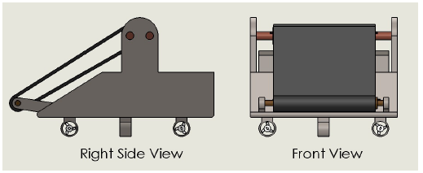
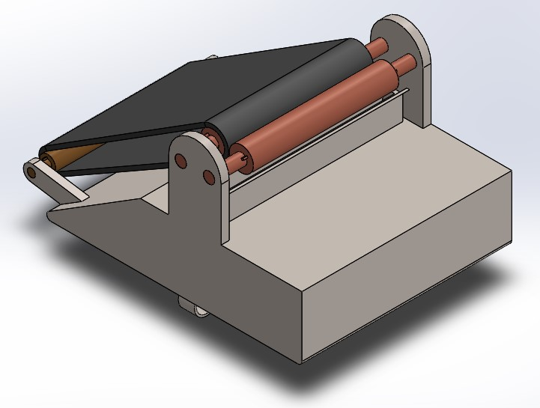
Design Synopsis
The prototype design is made using SolidWorks 2016.
Mechanism uses oleophilic skimmer (oil attracting material) like polyethylene terephthalate (PET), polypropylene, carbon-based sponges etc, to separate oil and water efficiently.
USVs can move in all directions (i.e) Mobility in all directions without direction change (3 DOF - Linear in X & Y and Rotation about Z).
The following are the basic dimensions of the prototype: 350 x 260 x 215 mm, Tank capacity: 4 litres.
Since this is a prototype, the dimensions can be scaled to meet the practical requirements.

Slide 8
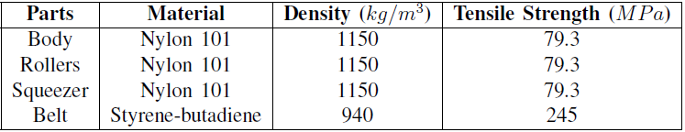
Material selection
As this is a surface vehicle, it should have low density.
At the same time, the load bearing components like rollers, squeezer and belt should have sufficient strength to withstand the load.
Manufacturing these parts can be made cost effective and faster if they are 3D printed.
Using these materials and considering additional components to be added such as motor, thrusters, batteries and other electronic components, the total estimated weight of the prototype is about 1.8 kg.
Assuming the belt runs at a speed of 20 rpm and the oil film on the belt has a thickness of 1 mm, the oil collection rate of the prototype is approximately 0.02 m3/h.

Slide 9
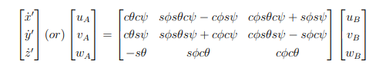

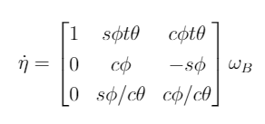
Mathematical Modelling of USV
Kinematics
It transforms velocities from body frame (B) to inertial or ground frame(A).

Slide 10
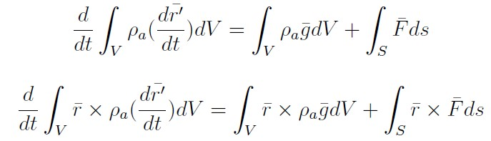
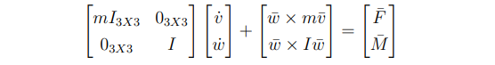
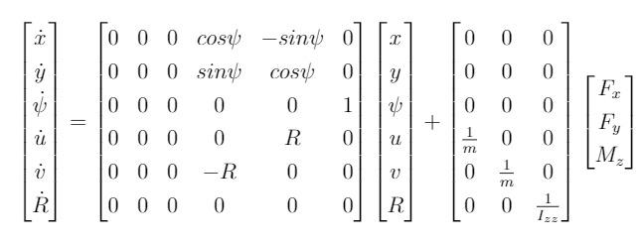
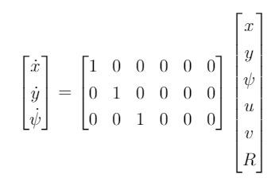
Dynamics
Using Newton’s laws of motion:
General dynamic governing equation:
Assuming the robot does not translate along Z axis and does not rotate about X and Y axis,
State Space Representation of the system is:

Slide 11
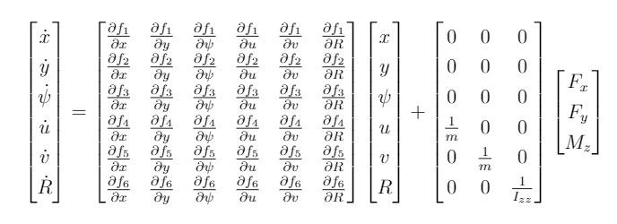
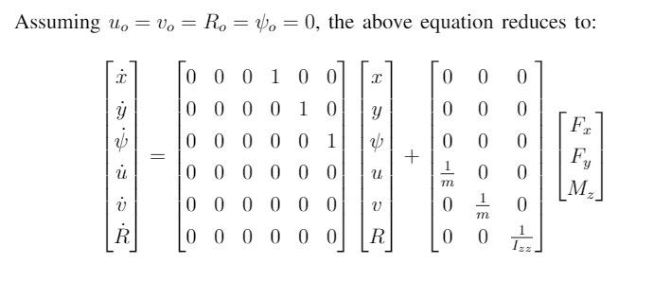
Linearization using Taylor series expansion:
After linearisation and combining all the equations, the complete state-space representation of the system :

Slide 12
Controller - PID
A proportional-integral-derivative controller (PID controller or three term controller) is a control loop feedback mechanism.
P Controller - depends on present error.
I Controller - on accumulation of past error.
D Controller - prediction of future errors based on current rate of change.
Input : Set points or Goal (x & y coordinates)
Error : Difference between goal pose and current pose (Pose = [x y theta].T)
Output : Thrusts and Moment

Slide 13

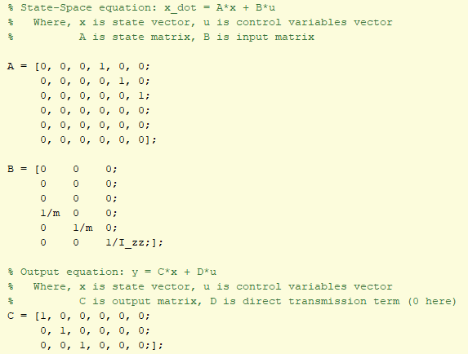
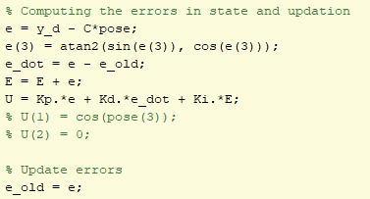
Matlab Code Snippet

Slide 14
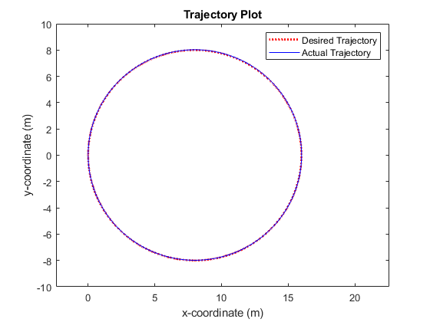
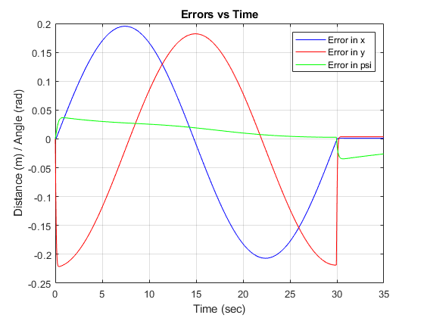
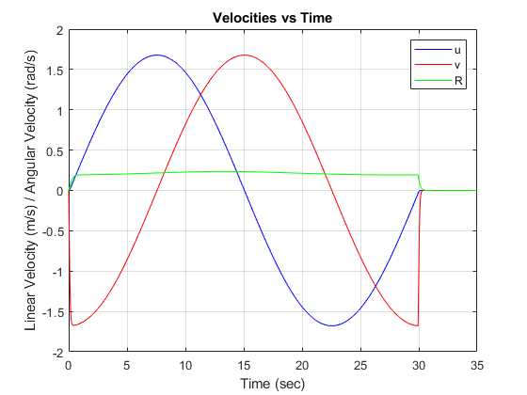
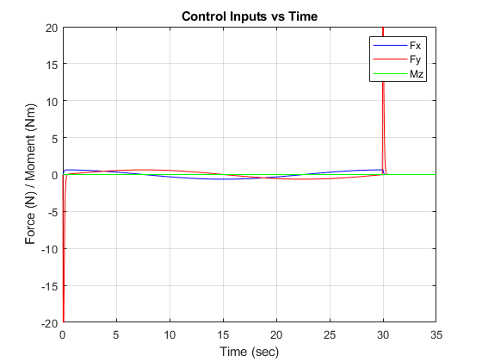
Results
Circular Trajectory

Slide 15
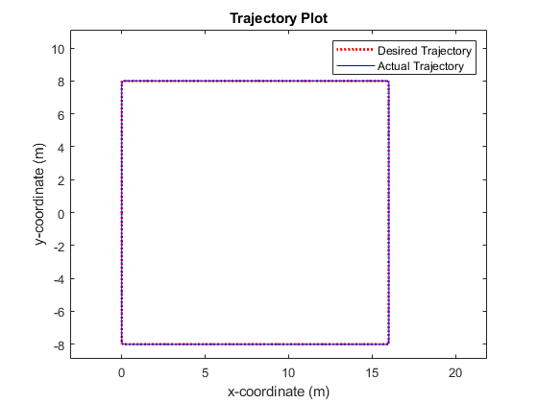
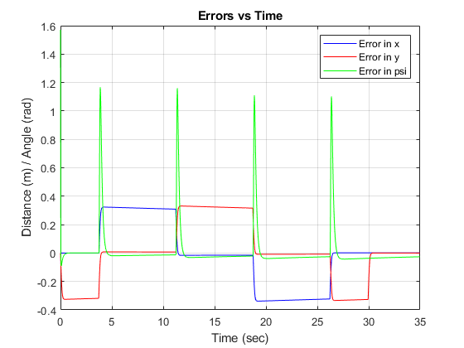
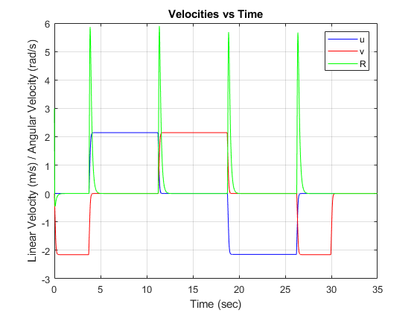
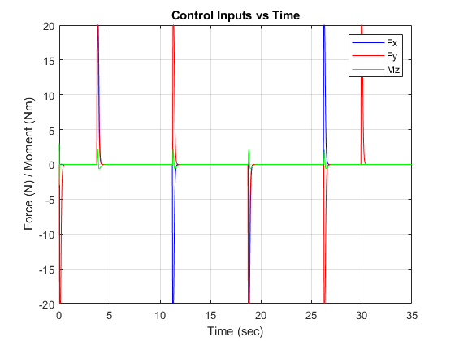
Square Trajectory

Slide 16
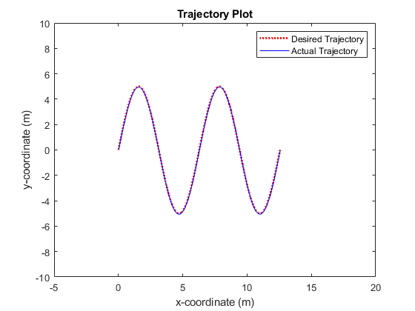
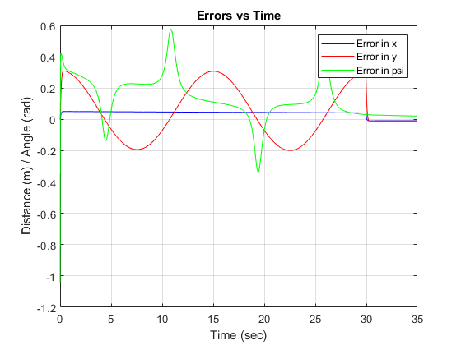
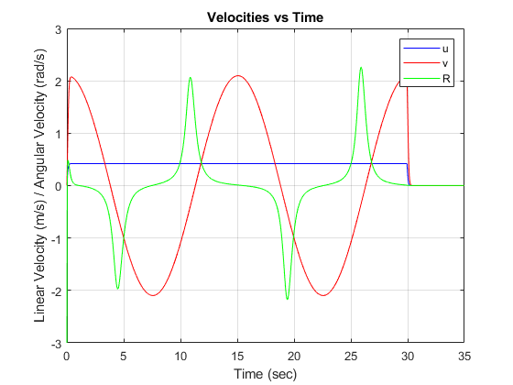
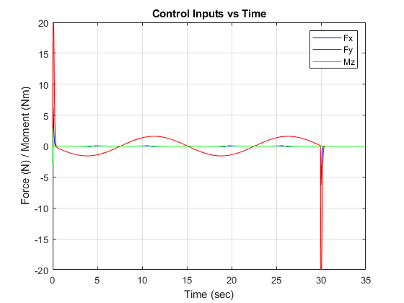
Sine Curve Trajectory

Slide 17
Future Scope
More accurate results could be obtained by including the dynamic wave model and drag forces.
The design could incorporate a hydraulic mechanism to enable inclination of thrusters to adapt to waves.
Modern and advanced controllers like Adaptive and Model Predictive Control could be implemented.
A collective system of proposed robots could work as swarm robots by meeting the specifications for any swarm robotic group in navigation, sensing, mobility and localization.
Various multi-agent path control algorithms like MAPP, MAPF, M* etc and path guidance algorithms like Dijkstra’s or A*, a could be implemented for better efficient and faster recovery.
In case there is no requirement for oil to be reused, each robot can be equipped with bio-degradation mechanism involving digestive chamber containing oil eating microbes.

Slide 18
References
Duong Nam Nguyen Anh Tuan Hoang Van Viet Pham. “A Report of Oil Spill Recovery Technologies”. In: International Journal of Applied Engineering Research ISSN (2018).
Josefina M´endez Eduardo P´asaro and Blanca Laffon. Aguilera Francisco. “Review on the Effects of Exposure to Spilled Oils on Human Health”. In: Journal of Applied Toxicology 30(4) (2010), : 291–301.
T.V. Prasad Emaad Mohamed H. Zahugi Mohamed M. Shanta. “Oil Spill Cleaning Up Using Swarm of Robots.” In: Advances in intelligent systems and computing (2013).
Jianhua Wang, Wei Gu, and Jianxin Zhu. “Design of an Autonomous Surface Vehicle Used for Marine Environment Monitoring”. In: 2009 International Conference on Advanced Computer Control (2009), : 405–409.
Kiam Heong Ang, G. Chong, and Yun Li. “PID control system analysis, design, and technology”. In: IEEE Transactions on Control Systems Technology 13.4 (2005).
GitHub Repository. URL: https://github.com/gnitish18/USV-Oil_ Spill.

